Slide 1
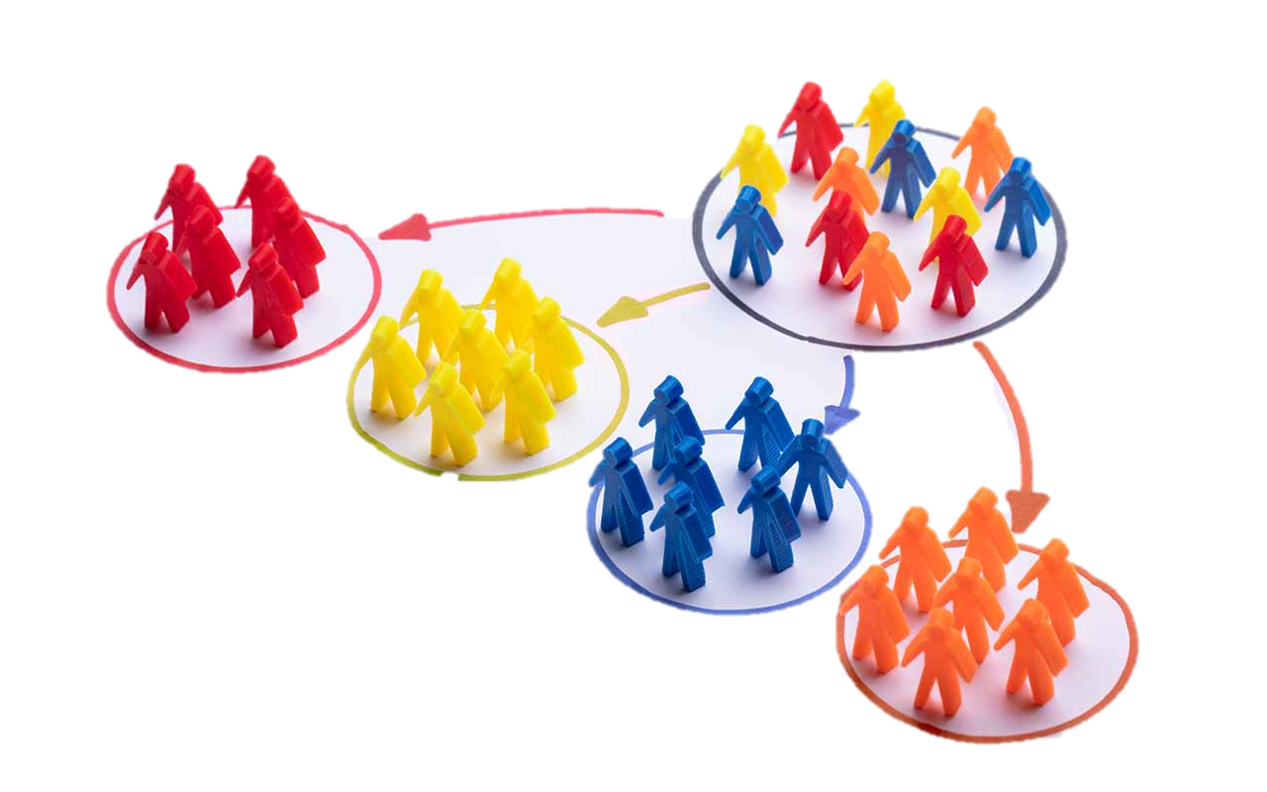
Customer Segmentation and Predicting the Optimal Frequency for Digital Advertising using Machine Learning & Data Analytics Techniques
- Priyanka BUDKULEY
Supervisor: Franck JAOTOMBO
Jury Member: Vincent Schoots

Slide 2

What is digital advertising?
Communicating with mass audiences through digital channels
What is brand recall?
The ability of the viewer or a potential customer to remember your brand

Slide 3
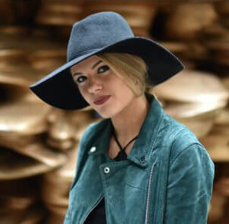


CUSTOMER PERSONAs
How can we segment customers for Digital Advertising?
AGE: 25 – 35
LOCATION: US
PROFILE: She carries herself with confidence with classic fragrances.
INTERESTS: Cosmetics, Fashion, Gucci
AGE: 18 – 30
LOCATION: UK
PROFILE: She is all for natural products
INTERESTS: Makeup, Fashion, Natural Beauty, Fragrance, Chloe
AGE: 30 – 40
LOCATION: Germany
PROFILE: He is looking for fragrances to gift his partner
INTERESTS: Gifting, Fashion, Fragrance, Lacoste

Slide 4

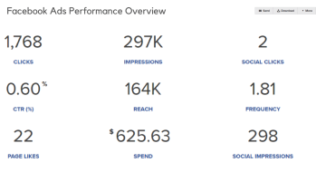
ADVERTISERS NEED TO THINK OF…
Creative to be used?
Campaign performance?
how many times should a viewer be exposed to the advertisement?

Slide 5
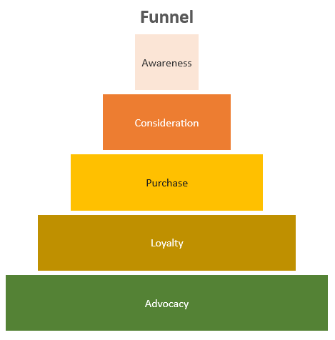
WHAT IS AN OPTIMAL FREQUENCY
The book Advertising Exposure, Memory and Choice mentions that the audience needs to be exposed to the ad, a higher number of times for the viewer to change their intent to purchase.
An increase was noted in the viewer’s consideration when they were exposed to the advertisement between 2 to 4 times. Although, it was significant that the recall value of the advertisement was higher when the viewer was exposed to the ad between 1-2 times. (Mitchell, 2013)
Eternity, an advertising agency, noted that the message was well received by the audience when exposed at least 3 times. (Richards, 2021)
The determination of healthy frequency depends on various factors, but studies show that the ideal frequency remains between 1-3; specially for brand awareness objective. (Ant, 2018)

Slide 6

DATASET
Dataset consists of Meta Ad Campaigns between:
October 2020 to September 2021
Rows: 21K
Variables: 42
Client: Coty (9 brands)

Slide 7

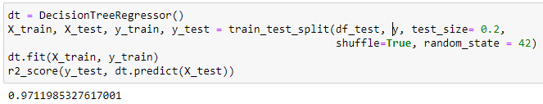
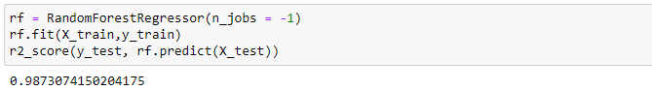
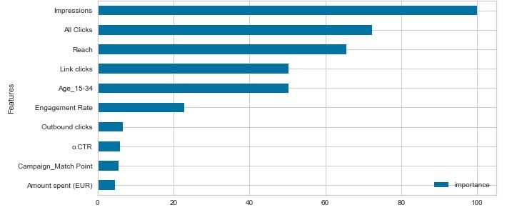
Top 10 variables related to frequency
DecisionTreeRegressor
RandomForestRegressor

Slide 8
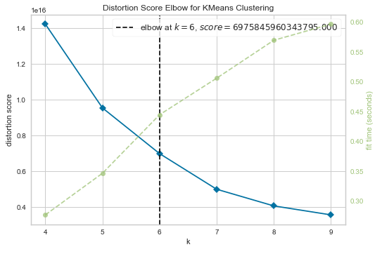
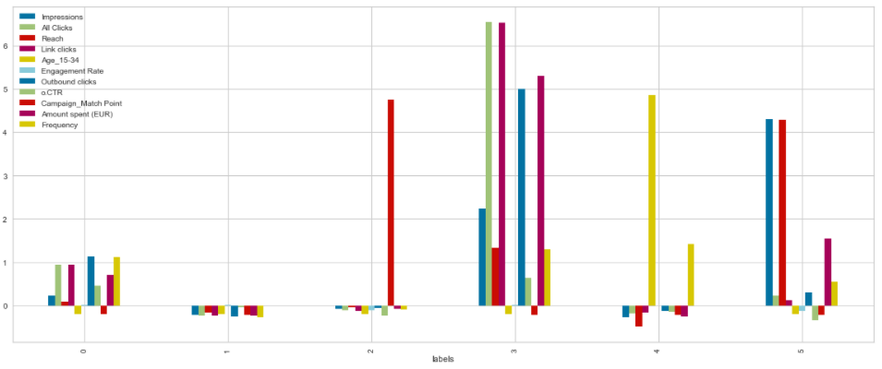
Clustering Campaigns based on similarities to find the best campaigns
K-Means and Elbow Technique
K = 6
Winning campaigns = 3

Slide 9
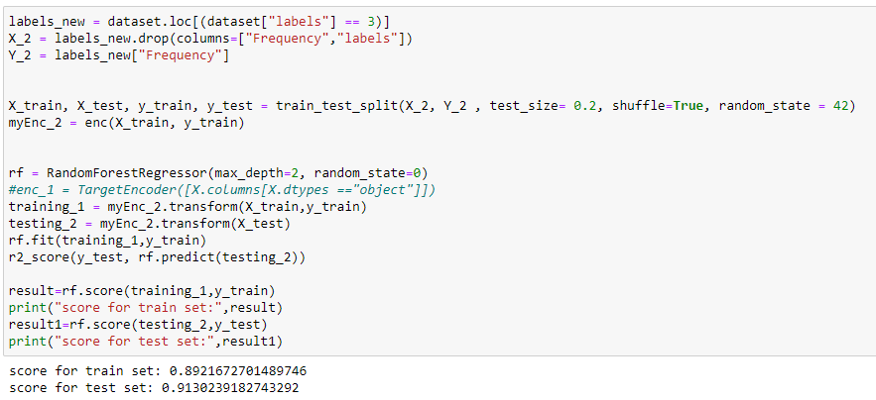
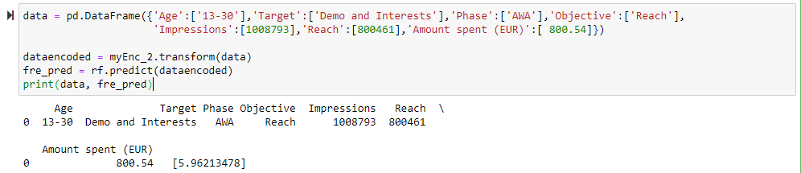
Frequency prediction model
Output:

Slide 10
Are Ad Recall and Brand Favorability Related?
Ad recall
A measurement to see the memorability of your advertisement for the customer.
Related variable = Frequency
Brand Favorability
A measurement of brand performance
Related variable = Outbound clicks, Link Clicks, All Clicks, 3 second VTR, outbound CTR
3/5 had a strong correlation

Slide 11
Limitations
Lack of sales data
Human errors in naming convention
Major part is manually managed; hence lack of sufficient measures for tracking.
No frequency capping done for traffic objective, currently

Slide 12
CONCLUSION
Ad recall and brand favorability impact each other; however, we did not note a strong relationship (3/5 variables were related)
Determining the optimal frequency depends on various factors, hence, it needs to be decided separately for each campaign.
The prediction model is designed to obtain an optimal frequency capping for each campaign, using all the variables that we have while setting up the campaign.

Slide 13
Thank you

